Slide 2
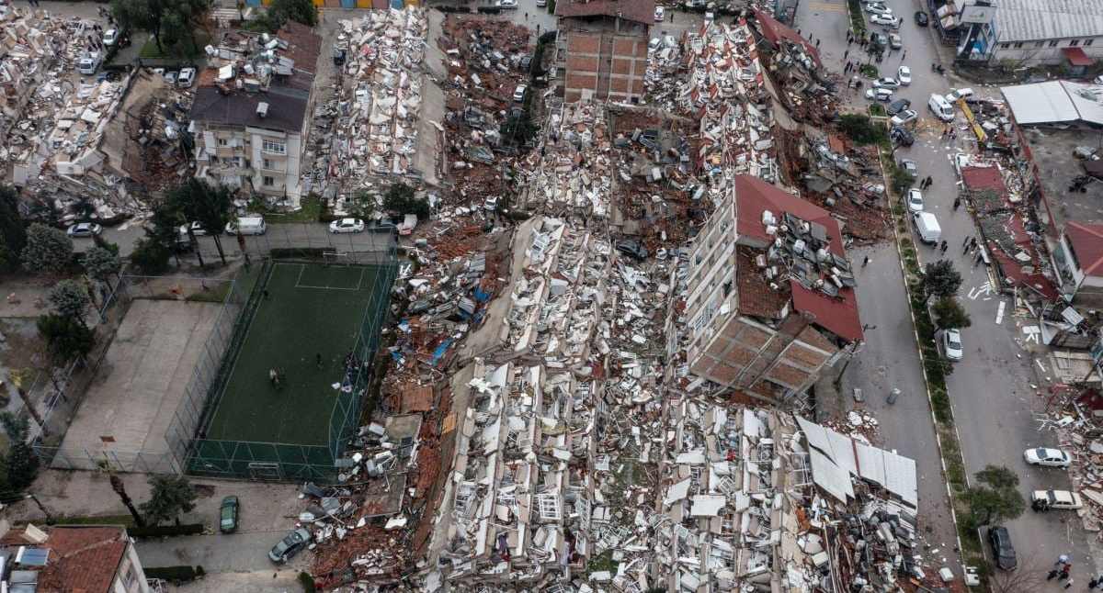

Slide 3
CURRENT STATUS
After two devastating earythquakes with magnitudes of 7.7 and 7.6 respectively, Turkey has suffered irreplacable loss in 10 cities. More than 20.000 people have died and that number is rising rapidly.
These 10 cities hosted 13,5M Turkish citizens and 1,7M Syrian refugees which adds up to 15,2M affected people. 1 of every 6 inhabitants in Turkey is affected by this disaster.
Not only the residences collapsed duing the earthquake, but also the government institutions. Most importantly hospitals were affected. Some cities suffer from a complete loss of hospitals after the earthquake. The remaining hospitals are trying to work over their capacity to serve the demand.
In a short time period the problems that are expected are as follows:
Shortage of clean water
Sewage and disposal problems
High risk of epidemic diseases
Other infections and diseases that would require immediate intervention
Interruptions in the care of chronic diseases like diabetics, high blood pressure
Discontinuation of continuous treatments like dialysis

Slide 4
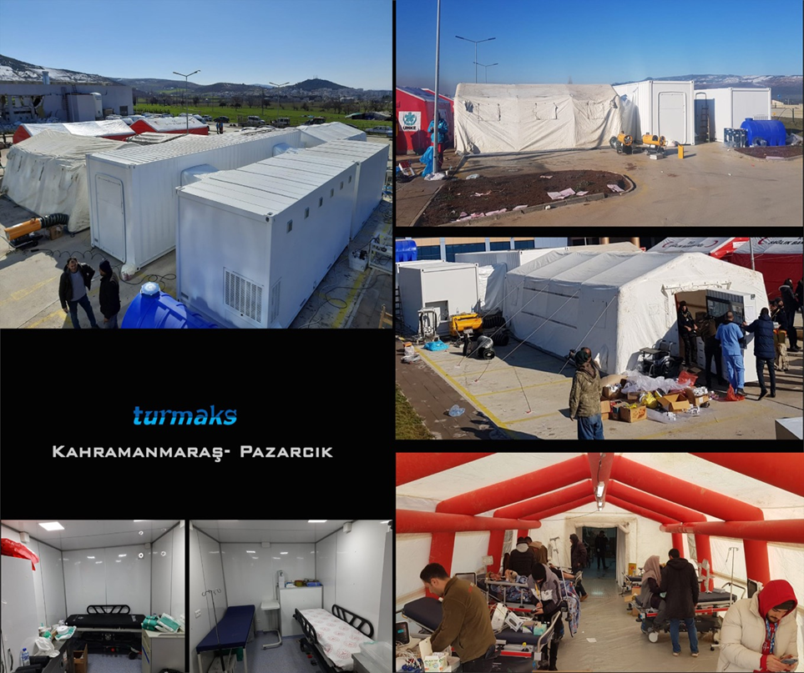
THE SOLUTION
As District 2420, we believe that supporting the healthcare services will go a long way. Thus we have decided to establish a field multi-clinic center to serve the victims in the affected area.
This Project will be done together with authorities, ensuring the continuance of:
Doctors and healthcare staff
Consumables needed in the care of the patients
Multi-clinic will be mobile, so it can be moved and re-assembled in other needed areas. The clinic will be consisting of a mixture of tent and containers. It will be an expandable structure, other modules or new beds could be added in the future
*- The images are from a similar project realized

Slide 5
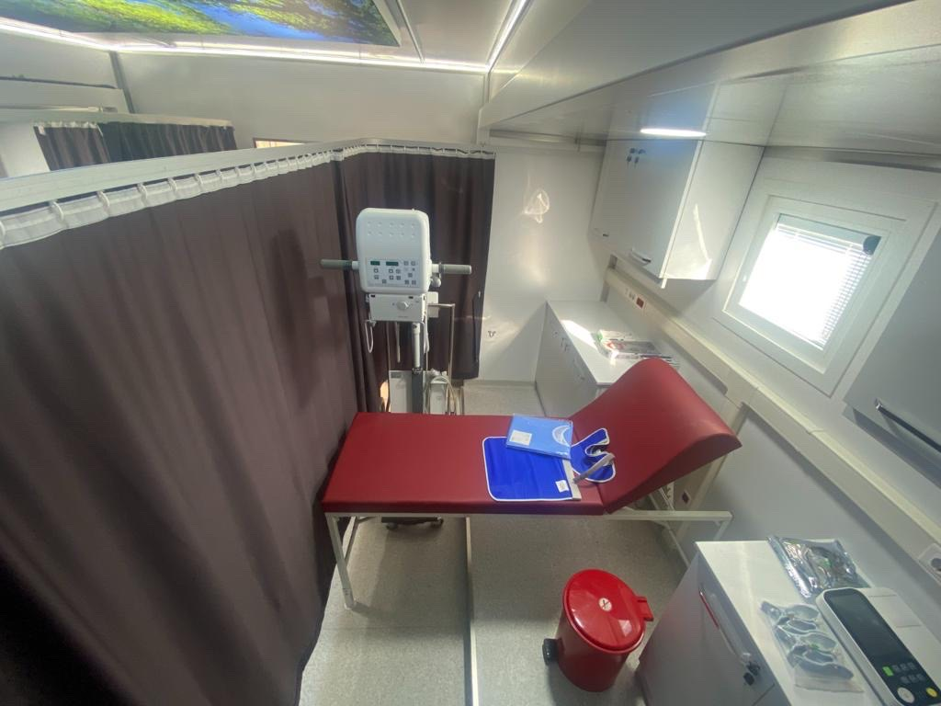
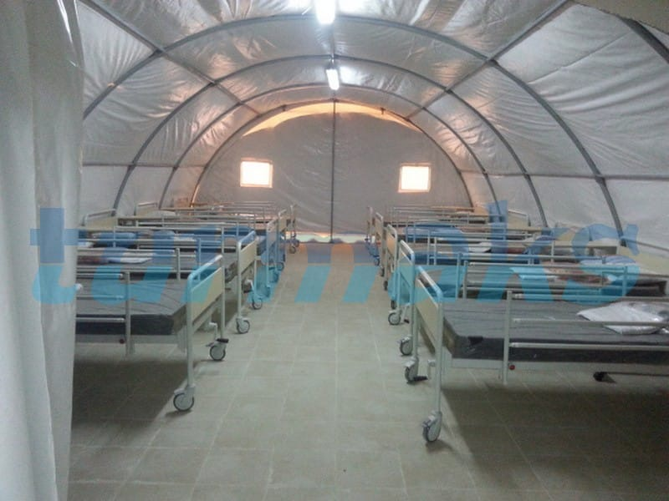
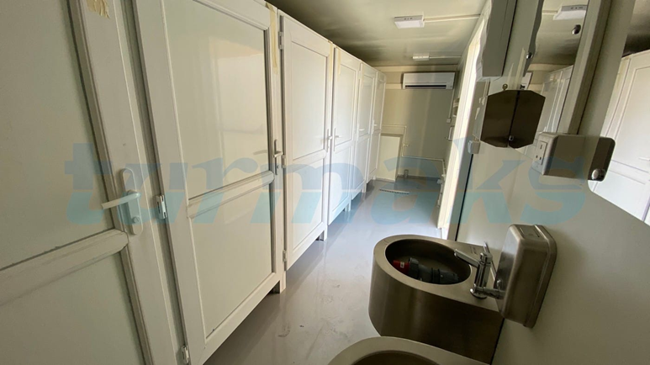
THE MULTI-CLINIC
The multi-clinic will be consisting of:
Emergency Room
Patient observation area with 4 beds
Laboratory
Clean and used water tanks
Electric generator
WC & Showers
Storage
The basic medical equipment and consumables will be supplied with the inital project. Continuation of the healthcare staff and consumables will be ensured by the Ministry of Health. It is planned to expand the structure and to equip the clinic with further diagnostic and treatment equipment short term.

Slide 6
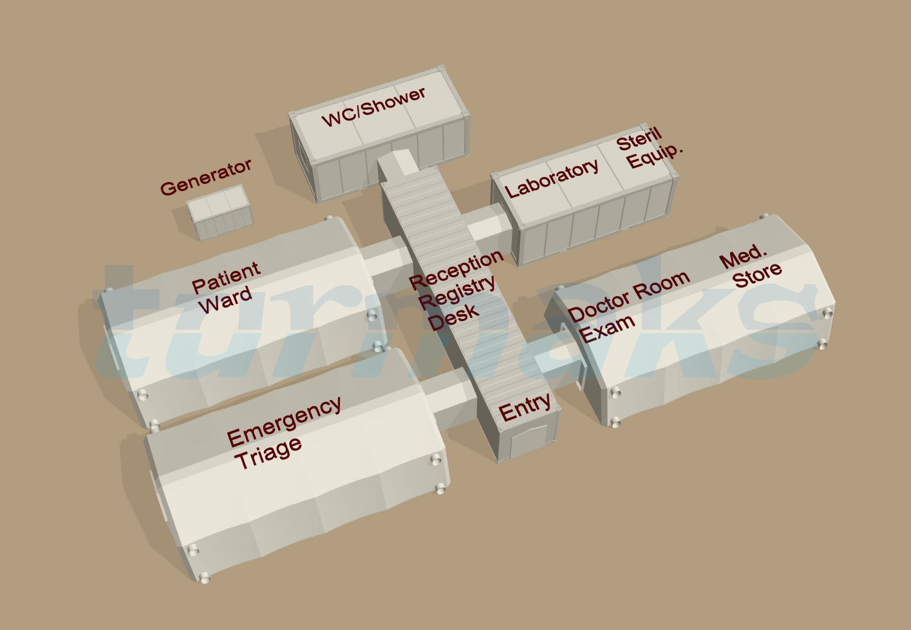

THE GLOBAL GRANT
The budget needed to realize this project is:
300.000 USD
Caddebostan RC has stepped up to be the host of this Global Grant, which will be supported by the funds accummulated District budget.

