Slide 1
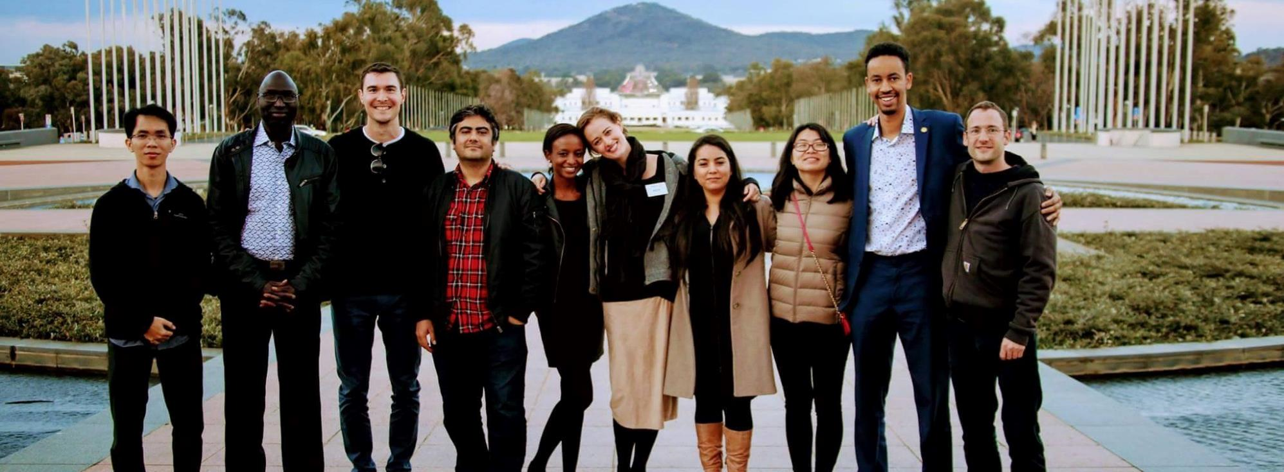
Rotary Peace Centers Fellowship
Notes:
In this presentation, you’ll learn about Rotary Peace Fellowships and the Rotary Peace Centers, hear from alumni who are working in the peace and development field, and find information on how to apply for a fellowship program through Rotary.

Slide 2
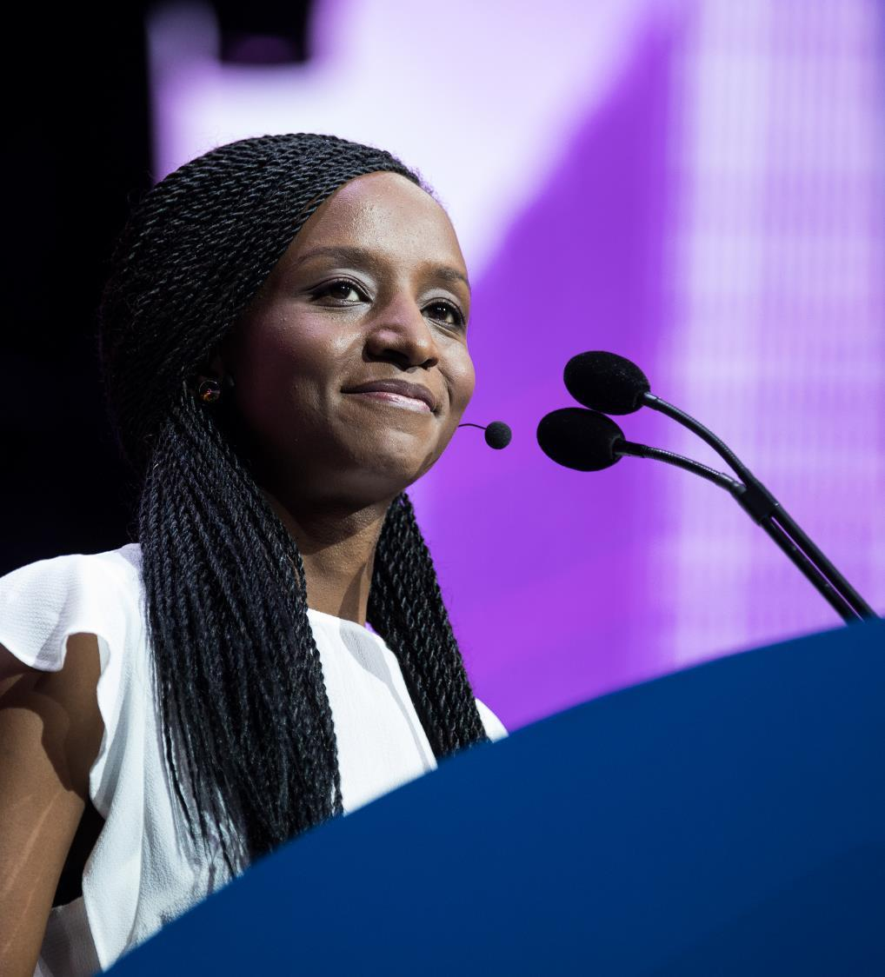
The Rotary Peace Centers program has a vision of sustainable peace — encompassing a network of peacebuilders and community leaders dedicated to preventing and resolving conflicts around the globe.
Notes:
The Rotary Peace Centers program has a vision of creating sustainable peace ― encompassing a network of peacebuilders and community leaders dedicated to preventing and resolving conflicts around the globe.

Slide 3
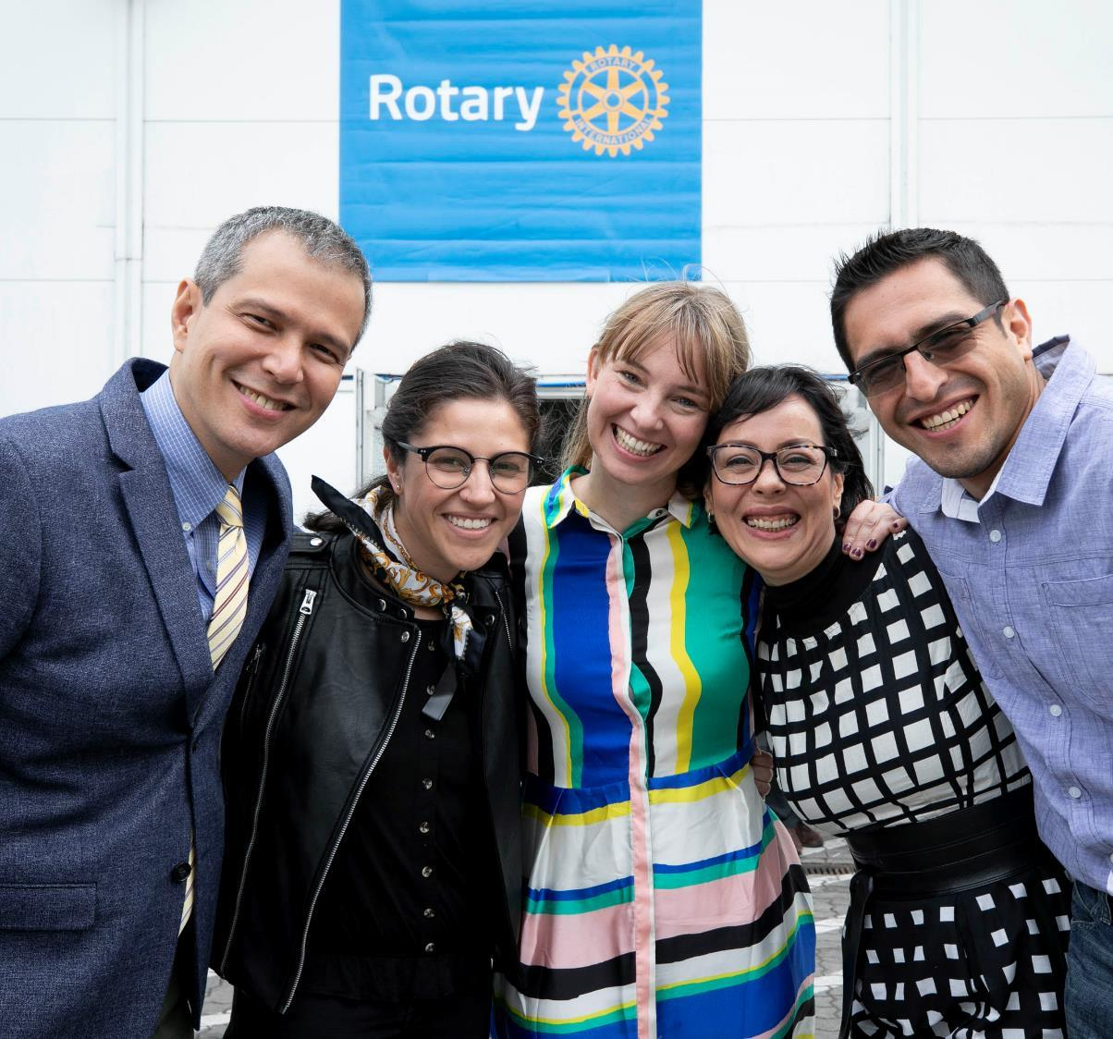
Rotary partners with leading universities to host Rotary Peace Centers that empower, educate, and increase the capacity of peacebuilders.
Notes:
To serve this vision, Rotary has developed partnerships with renowned universities that host the Rotary Peace Centers. The centers empower, educate, and increase the capacity of peacebuilders through rigorous academic training, practice, and global networking opportunities.

Slide 4
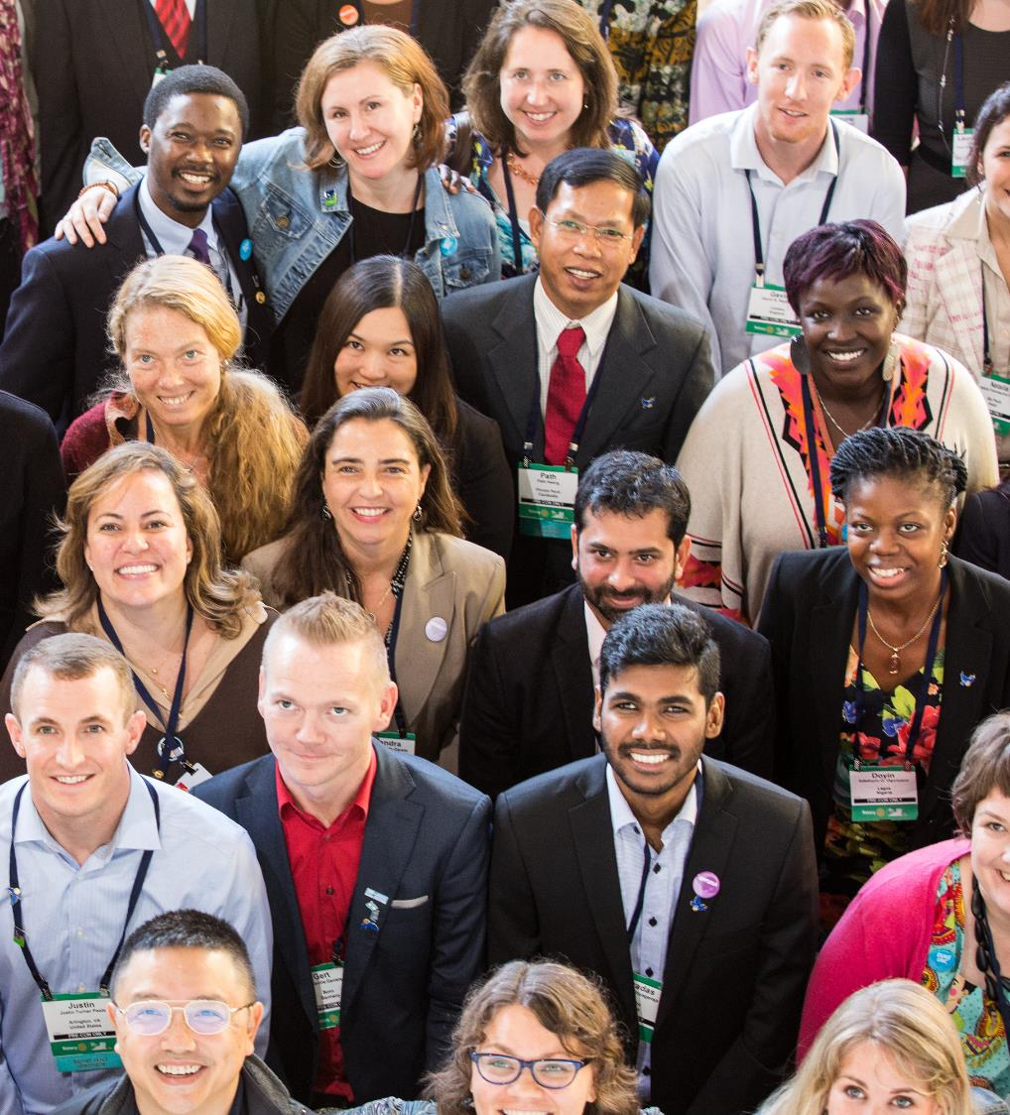
More than 1,600 program alumni are working on peace and development in more than 140 countries.
Notes:
Since the Rotary Peace Centers began in 2002, over 1,600 people have graduated from our programs and are working on peace and development initiatives in more than 140 countries.

Slide 5
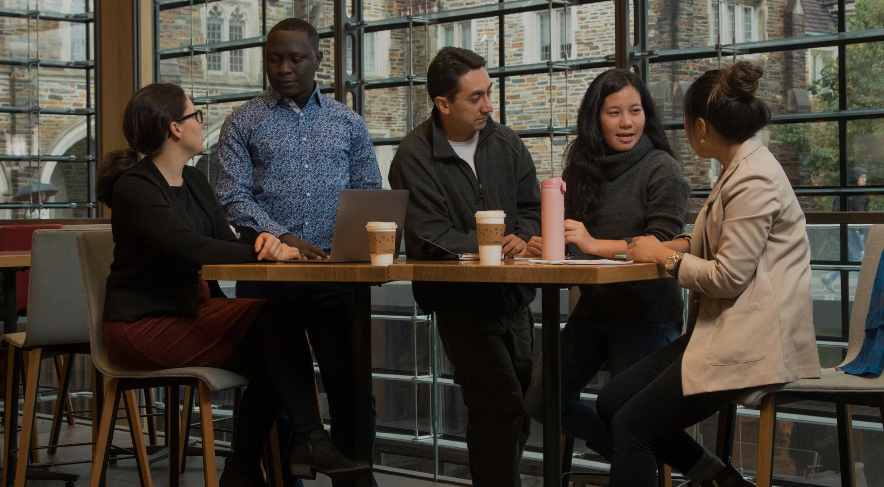
Our Programs

Slide 6
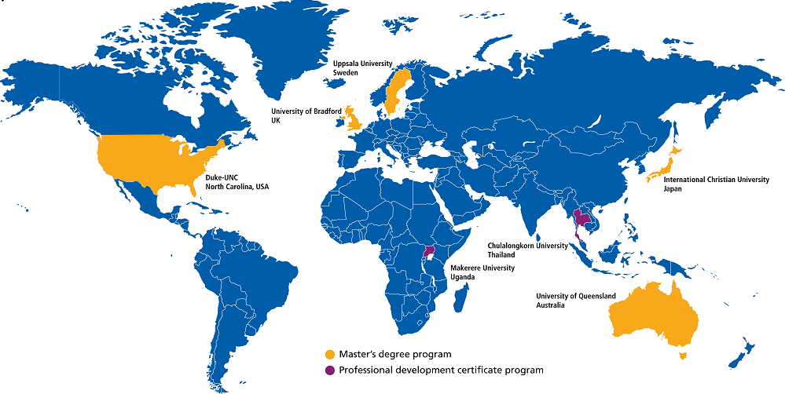

Rotary Peace Centers
*Please note that the certificate program at Chulalongkorn University in Thailand is not accepting applications in 2023, as The Rotary Foundation and the university conduct an evaluation of the program.
Notes:
We have seven Rotary Peace Centers at eight universities.
Five centers offer master’s degrees in disciplines related to peace and development:
A joint program at Duke University and the University of North Carolina-Chapel Hill, USA
International Christian University, Japan
University of Bradford, England
University of Queensland, Australia
Uppsala University, Sweden
Our center at Makerere University in Uganda, offers a post-graduate diploma in peace and development. The yearlong program blends online learning, classroom studies, and a social change initiative.
*Please note that the certificate program at Chulalongkorn University in Thailand is not accepting applications in 2023, as The Rotary Foundation and the university conduct an evaluation of the program.

Slide 7
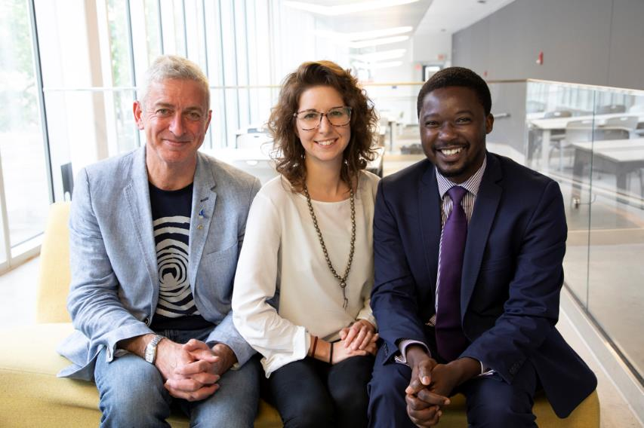
Master’s program:
Those near the start of their careers
50 fellows per year (10 per center)
15-24 month course
Certificate program:
Proven peace and development leaders
40 fellows this year (20 per cohort)
One-year blended learning program intended for working professionals
Master’s and Certificate programs
Notes:
Each year, Rotary Peace Fellows are selected to earn a master’s degree or a professional development certificate.
The two programs were created to provide those near the start of their careers, as well as those with proven experience, with the educational opportunities that will further their careers in peacebuilding and development.
Each year, 50 fellows are assigned to a master’s program (10 per center) that lasts from 15 months to two years.
This year, we will select 40 fellows to participate in the one-year post-graduate certificate program, with two cohorts of up to 20 fellows participating at Makerere University

Slide 8
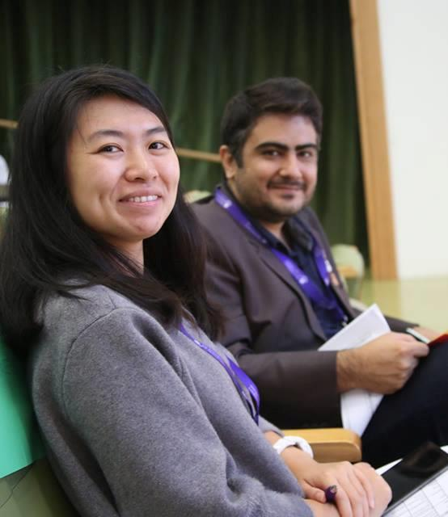
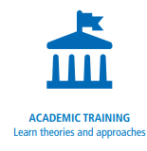
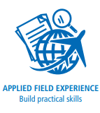

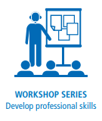
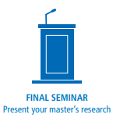
Master’s program
Fellowship components
Notes:
Teaching in the master’s programs is grounded in practical research. Students are enrolled graduate students with diverse backgrounds and professional experience.
Fellows selected for the master’s program benefit from:
Academic training with diverse curricula. The centers build on the unique strengths of their university hosts and offer courses that examine peace and conflict through various frameworks. At all centers, the core coursework includes peace and conflict resolution with a focus on negotiation, mediation, human rights, or international development.
A fully funded applied field experience of 2-3 months that they design and carry out--an opportunity to put theory into practice.
Opportunities to network with a cohort of diverse peace fellows as well as with Rotarians at home and in their host countries.
A Rotary-sponsored workshop series that helps them develop professional skills in resiliency.
The chance to present their research during an annual seminar hosted by the universities and local Rotarians.

Slide 9
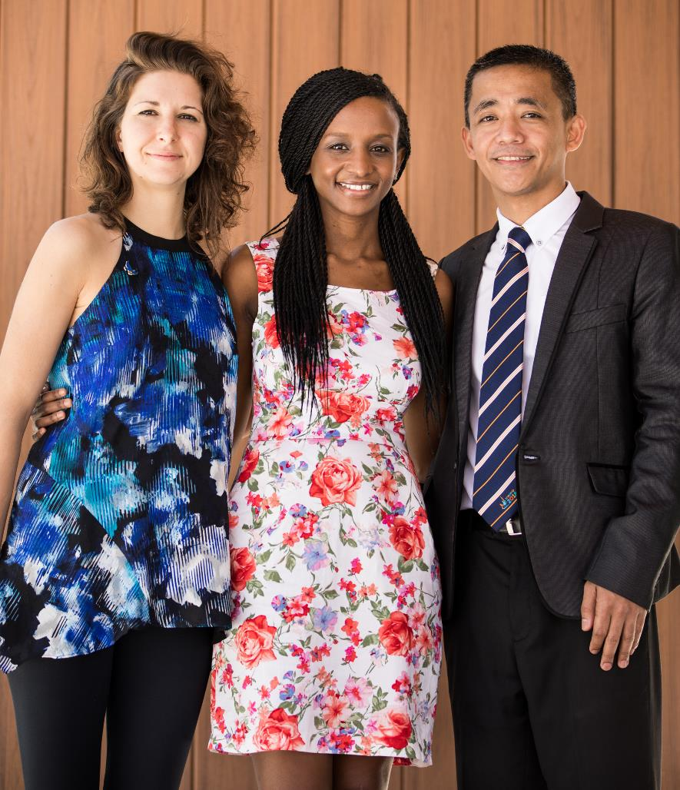
Master’s degree candidates must:
Be proficient in English
Have a bachelor’s degree
Have a strong and proven commitment to cross-cultural understanding and peace
Demonstrate leadership skills
Have at least three years of full-time experience in peace or development work (five years for the Duke program)
Notes:
The ideal master’s candidate is academically strong, has a bachelor’s degree in a related field, and has work experience in peace and development that aligns with Rotary’s mission.
Candidates need to demonstrate a commitment to peace and conflict resolution, be able to undertake extensive reading and research, and be able to actively participate within a diverse cohort of students.
After the program, candidates should be willing to share their own work and experience, staying in touch with peace fellows in their region and maintaining strong connections with Rotary members.
Master’s degree candidates must also:
Be proficient in English
Have a strong commitment to cross-cultural understanding and peace as shown through professional and academic achievements and personal or community service
Demonstrate leadership skills
Have at least three years of full-time experience in peace or development work

Slide 10
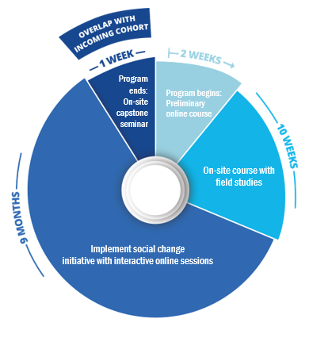
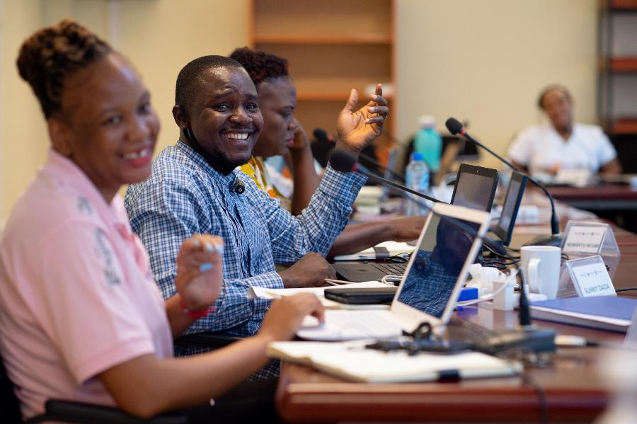
Certificate program
Fellowship components
Notes:
The professional development certificate program is aimed at mid-career peace and development leaders with at least five years of relevant work experience. This program is intended for working professionals and requires 11 weeks of on-site participation. Fellows earn a post-graduate diploma upon completion of the program.
During the one-year program, students with diverse backgrounds and professional experience gain practical skills to promote peace in their communities and around the globe. Candidates need to come to the program with a social change initiative to promote peace and development within the program region and have a clear vision of how the fellowship experience and network will help advance their peace work and increase their impact.
Rotary is selecting a cohort of up to 20 peace fellows to begin studies in January and September at Makerere University. The cohorts will have some overlap to encourage a sense of community and increase networking opportunities.
The program includes:
An online preliminary course that provides baseline knowledge and sets expectations for incoming fellows
A 10-week on-site course that includes field studies
A 9-month independent project period, with interactive online sessions, during which fellows work on a social change initiative in their community or workplace.
A one-week capstone seminar for fellows to reflect and report on their Positive Peace efforts and impact.

Slide 11
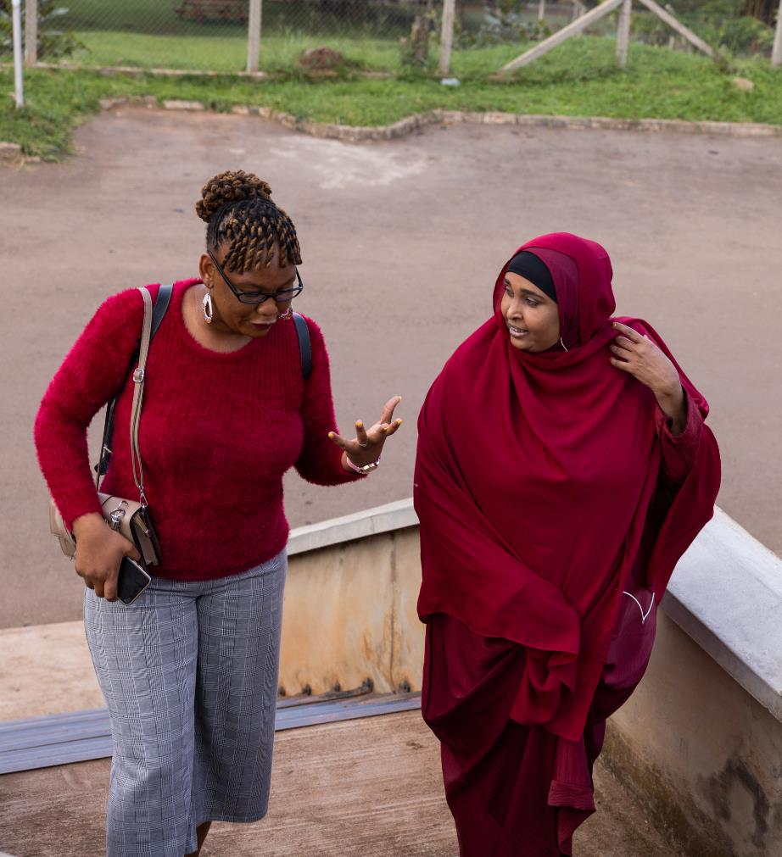
Certificate candidates must:
Be proficient in English
Have a bachelor’s degree
Have a strong and proven commitment to cross-cultural understanding and peace
Demonstrate leadership skills
Have at least five years of full-time experience in peace or development work
Be able to explain how their plan to promote peace aligns with Rotary’s mission
Candidates for Makerere University: Either be from Africa, have worked in Africa, or work with African communities or initiatives outside the continent.
Notes:
The ideal candidate is a proven peace and development leader with at least five years of relevant work experience.
Candidates need to come to the program with an idea for a social change initiative to promote peace and development in the program region or their community. They also need a clear vision of how the fellowship experience and network will advance their peace work and increase their impact.
After the program, candidates should be willing to share their own work and experience, staying in touch with peace fellows in their region and maintaining strong connections with Rotary members.
Certificate candidates must also:
Be proficient in English
Have a bachelor’s degree
Have a strong commitment to cross-cultural understanding and peace as shown through professional and academic achievements and personal or community service
Demonstrate leadership skills
Be able to explain how their plan to promote peace aligns with Rotary’s mission
Candidates for Makerere University: Either be from Africa, have worked in Africa, or work with African communities or initiatives outside the continent.

Slide 12
Active Rotary members, or Rotaract members who are also Rotary members, and their spouses or lineal descendants are not eligible.
Rotaract club members who are not also Rotary club members are eligible to apply.
Rotary Peace Fellows who have completed the certificate program or a Global Grant Scholarship, must wait 3 years between the end date of that program and their intended start date for the fellowship.
Candidates must have at least 3 years between the completion of their most recent academic degree program (undergraduate or graduate degree) and their intended start date for the fellowship. Candidates currently enrolled in an undergraduate or graduate program are not eligible to apply.
Eligibility restrictions
Notes:
Rotary Peace Fellowships may not be used for doctoral study.
Active Rotary members, or Rotaract members who are also Rotary members, and their spouses or lineal descendants are not eligible. Former Rotary members & their relatives must wait 3 years after their resignation to apply. Please refer to the Rotary Peace Centers web pages for full details.
Rotaract club members who are not also Rotary club members are eligible to apply.
Rotary Peace Fellows who have completed the certificate program or a Global Grant Scholarship, must wait three years between the end date of that program and their intended start date for the fellowship.
Lastly, candidates must have at least three years between the completion of their most recent academic degree program (undergraduate or graduate degree) and their intended start date for the fellowship. Candidates currently enrolled in an undergraduate or graduate program are not eligible to apply.

Slide 13
Master’s funding includes:
Tuition
Room and board
Travel to and from country of study
Internship expenses
Conference/research expenses
Insurance
Contingency fund
Certificate funding includes:
Tuition
On-campus accommodations
Travel to and from country of study
Field study expenses
Course materials
Insurance
Fellowship funding
Total average funding:
Master’s fellowship: US$100,600
Certificate fellowship: US$11,400
Notes:
The Rotary Peace fellowship is generous and comprehensive.
The fellowship funding includes tuition, accommodations, travel, and field experience expenses.

Slide 14
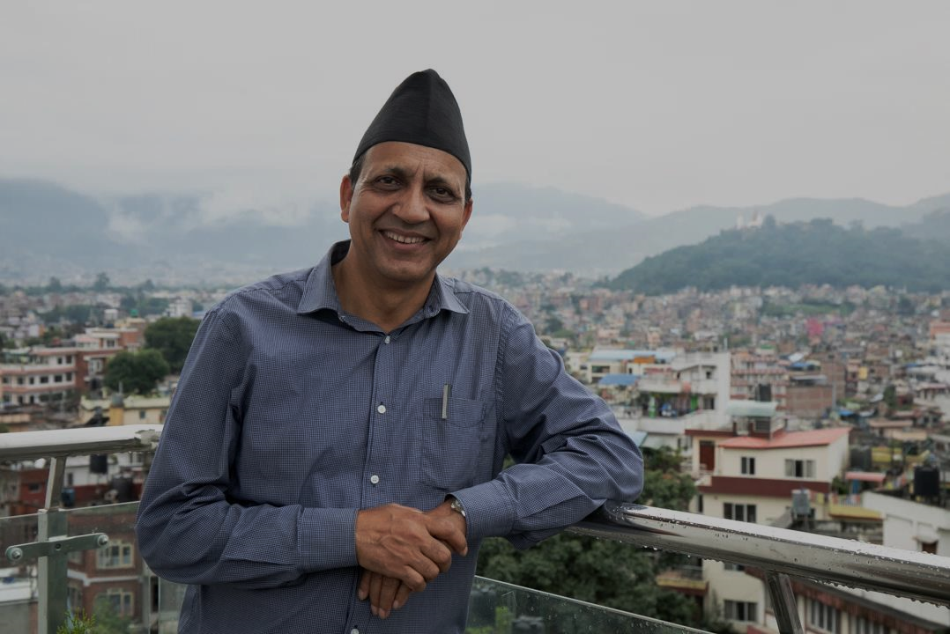
Rotary Peace
Fellow Alumni

Slide 15
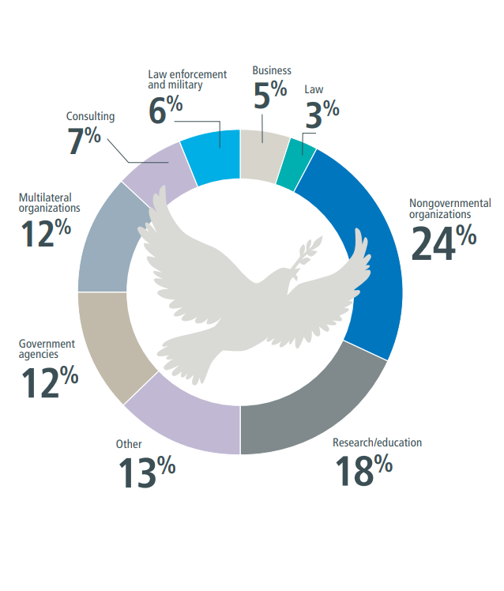
Program alumni serve as leaders in government and nongovernment agencies, education and research, multilateral organizations such as United Nations agencies and the World Bank, law enforcement and the military, law, media and the arts, and other peacebuilding organizations.
Notes:
93% of the more than 1,600 working alumni say they are in jobs connected to peace and development in more than 140 countries.
• 24% Nongovernmental organizations
• 18% Research/education
• 13% Other
• 12% Government agencies
• 12% Multilateral organizations
• 7% Consulting
• 6% Law enforcement and military
• 5% Business
• 3% Law

Slide 16
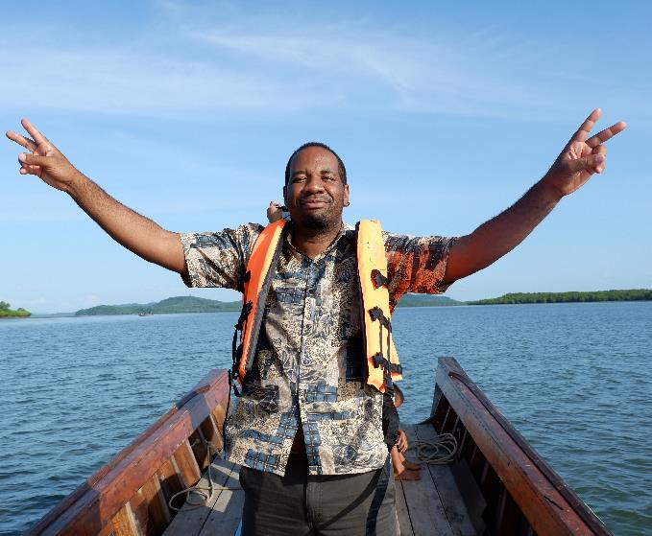
Visit rotary.org/peace-fellowships to see the eligibility requirements and restrictions. Applications are available in February.
Research the curriculum and programs at each Rotary Peace Center. Be prepared to rank two centers for the master’s program or choose one for the certificate program.
Applications require a resume, academic and/or professional recommendations, essays, transcripts from postsecondary college and universities attended (master’s only), English language proficiency test scores (master’s only), and social impact plan (certificate only).
Use the Club Finder to locate a club near you and engage with Rotary.
Submit the online application to The Rotary Foundation by 15 May.
Get endorsed. In early June, qualified applications will be assigned to a trained Rotary endorser who is either a Rotary club member or a program alumnus. Your assigned endorser will reach out to schedule an interview and will submit their endorsement decision by 1 July.
How to apply
Notes:
How to apply
Candidates can access the online application beginning in February and should carefully review all eligibility requirements and restrictions as well as thoroughly research the curriculum and programs at each Rotary Peace Center and be ready to rank top 2 centers for the master’s program or choose one for the certificate program.
Applications require a resume, academic and/or professional recommendations, essays, transcripts from postsecondary college and universities attended (master’s only), English language proficiency test scores (master’s only), and social impact plan (certificate only).
Candidates are encouraged to engage with a Rotary club to learn about Rotary’s work in their community and globally. Candidates can use the club finder to identify a Rotary Club near them. The club recommendation is an optional part of the application process, yet highly recommended.
Candidates submit the online application to The Rotary Foundation by 15 May.
Get endorsed. In early June, if your application meets the qualification and eligibility criteria, it will be automatically assigned to a trained Rotary endorser who is either a Rotary club member or a program alumnus. Your assigned endorser will reach out to you to schedule an interview during the month of June. The Rotary endorser will interview you, then submit an endorsement decision for your application by 1 July.

Slide 17
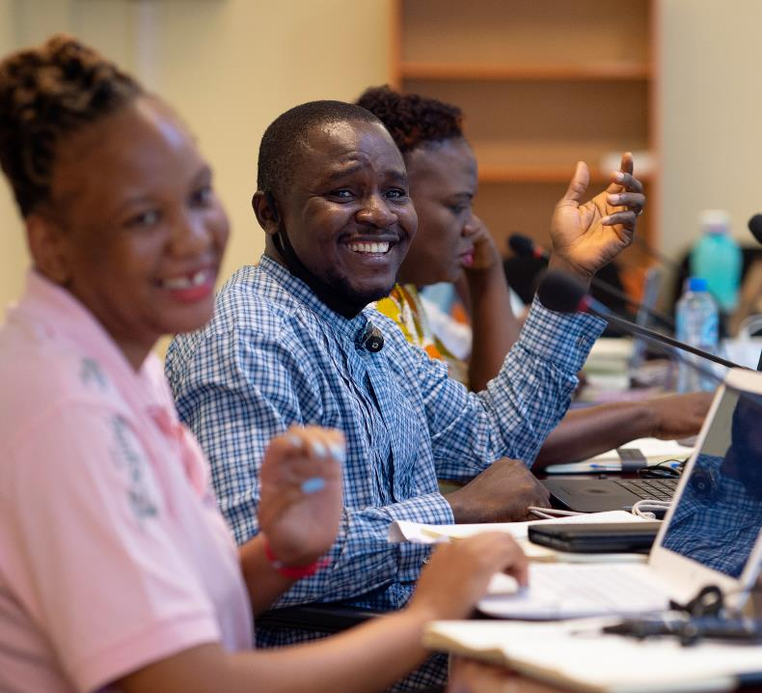
July to October: The Rotary Peace Centers Committee, composed of Rotarians and university representatives, screens applications and selects finalists based on the following criteria:
  Commitment to peace and development
  Leadership potential
  Compatibility with fellowship objectives and fit with Rotary
  Academic record and compatibility with preferred university program
  Certificate candidates only: Feasibility and impact of Social Change Initiative
Candidates will be notified of the Rotary Foundation’s decision in November.
Once selected, master’s fellowship finalists must apply separately for university admission.
Selection process
Notes:
Selection process:
Between July and October, the Rotary Peace Centers Committee, composed of Rotarians and university representatives, screens applications and selects the ﬁnalists based on the following criteria:
Commitment to peace and development
Leadership potential
Compatibility with fellowship objectives and fit with Rotary
Academic record and compatibility with preferred university program
Certificate candidates only: Feasibility and impact of Social Change Initiative
All applicants are notified of the results in November. Master’s finalists then apply to the university for acceptance.
Once selected, master’s fellowship finalists must apply separately for university admission.

Slide 18
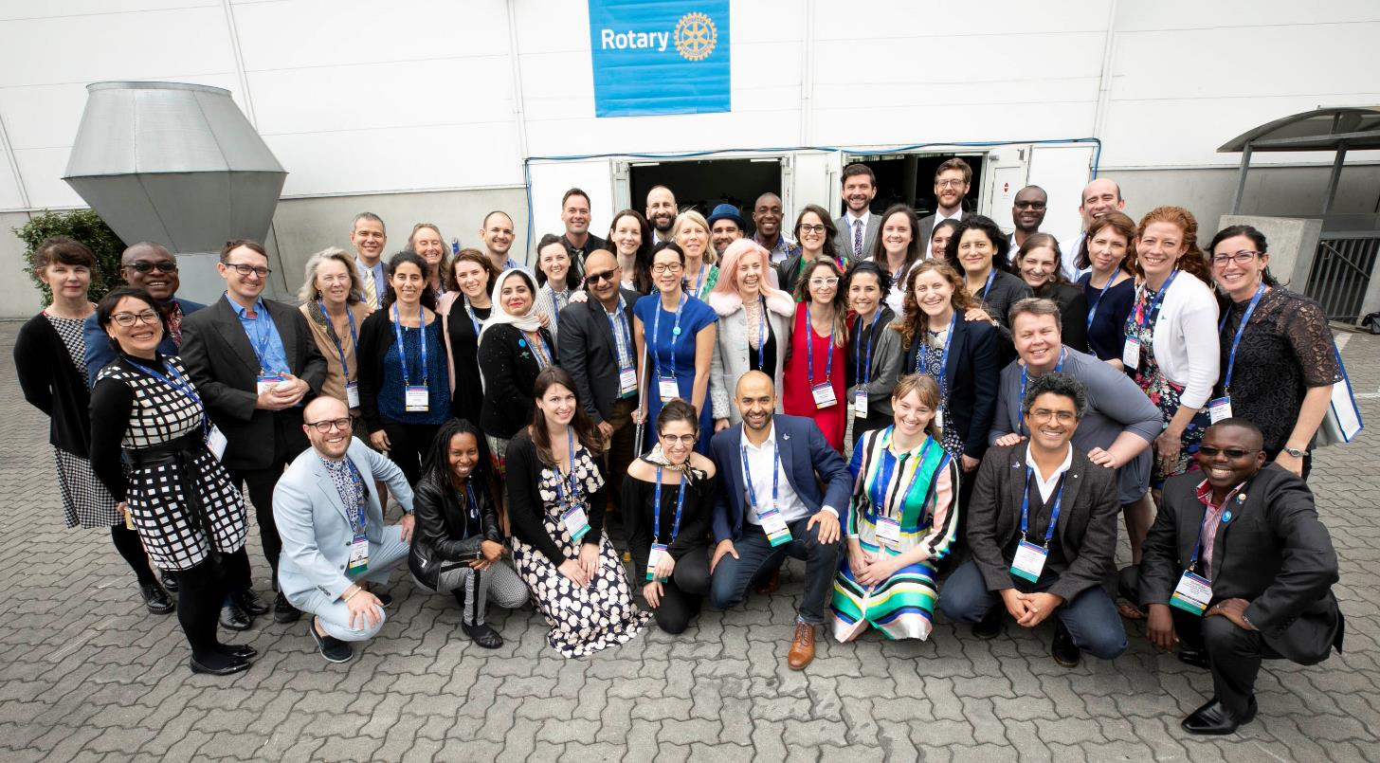
Rotary Peace Centers
For more information, write to us at:
rotarypeacecenters@rotary.org
Caption here. Replace the map image with a graphic from the web or your documents.

